Slide 1

Note: The data and information in this document is reflective of a hypothetical situation and client. This document is to be used for KPMG Virtual Internship purposes only.
Sprocket Central Pty Ltd
Data analytics approach
[Division Name] - [Engagement Manager], [Senior Consultant], [Junior Consultant]

Slide 2
Note: The data and information in this document is reflective of a hypothetical situation and client. This document is to be used for KPMG Virtual Internship purposes only.
Agenda
Introduction
Data Exploration
Model Development
Interpretation

Slide 3
Note: The data and information in this document is reflective of a hypothetical situation and client. This document is to be used for KPMG Virtual Internship purposes only.
Introduction
About Company
Data sheet
Sprocket Central Pty Ltd is a long-standing KPMG client whom specialises in high-quality bikes and accessible cycling accessories to riders.
Transactions
CustomerDemographic
CustomerAddress
Goals
The marketing team is looking to boost business by analysing their existing customer dataset to determine customer trends and behaviour.

Slide 4
Note: The data and information in this document is reflective of a hypothetical situation and client. This document is to be used for KPMG Virtual Internship purposes only.
Data Exploration
Total Revenue and Age groups
Customer almost come from Old and Adults group. It is greater than 40 years old and between 24 and 40 years old.

Slide 5
Note: The data and information in this document is reflective of a hypothetical situation and client. This document is to be used for KPMG Virtual Internship purposes only.
Data Exploration
State and Transaction
Almost transactions from customer that they live in New Soulth Wales. They tend to consume more than others place.

Slide 6
Note: The data and information in this document is reflective of a hypothetical situation and client. This document is to be used for KPMG Virtual Internship purposes only.
Data Exploration
Most purchased product line
Standard product line is the most purchased product from consumers. It account for 72% in the total.

Slide 7
Note: The data and information in this document is reflective of a hypothetical situation and client. This document is to be used for KPMG Virtual Internship purposes only.
Model Development
Marketing team should review the insights to develop model:
Concentrate on customers who are greater than 24 years old.
New Soulth Wales is the best place for sales.
People almost buy Standard product line more than others.
Consumers from Adult and Old group spend more money than other groups.

Slide 8
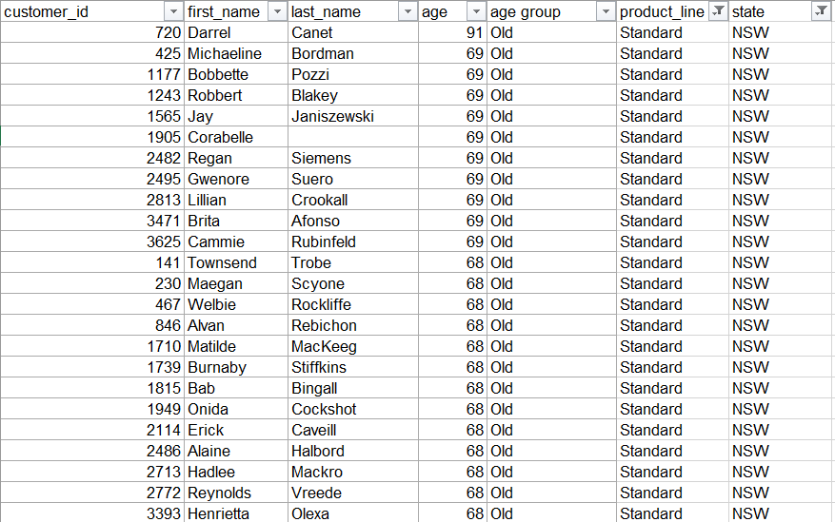
Note: The data and information in this document is reflective of a hypothetical situation and client. This document is to be used for KPMG Virtual Internship purposes only.
Interpretation

Slide 9
Note: The data and information in this document is reflective of a hypothetical situation and client. This document is to be used for KPMG Virtual Internship purposes only.
Appendix

Slide 10
Note: The data and information in this document is reflective of a hypothetical situation and client. This document is to be used for KPMG Virtual Internship purposes only.
Appendix
This is an optional slide where you may place any supporting items.

